Slide 1
CPITCH^2 and CPITCH^2 ~OP
An Introduction

Slide 2
Mathematical Description of CPITCH^2

Slide 3
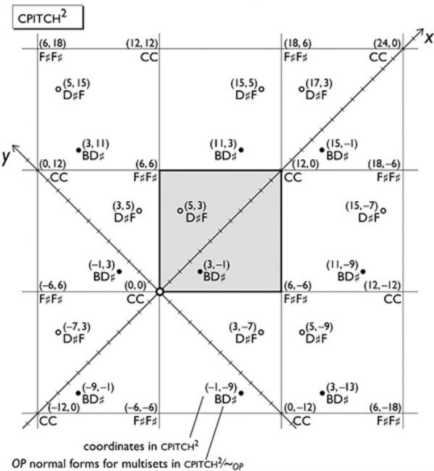
CPITCH^2 is constructed by taking the product of CPITCH (the real line of nonnegative frequencies) with itself, yielding an ‘xy-plane’ of frequencies as shown below:

Slide 4
Musical Interpretation of CPITCH^2

Slide 5
Prerequisites: Contrapuntal Motion
Contrapuntal motion is the melodic motion of two voices. This includes parallel motion, contrary motion, and oblique motion.
Many famous composers used contrapuntal motion in their pieces, including Bach, Mozart, and Beethoven

Slide 6
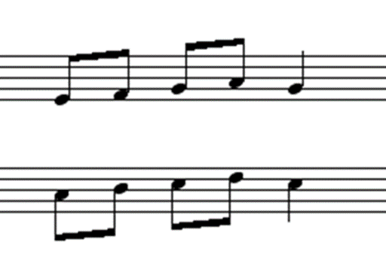
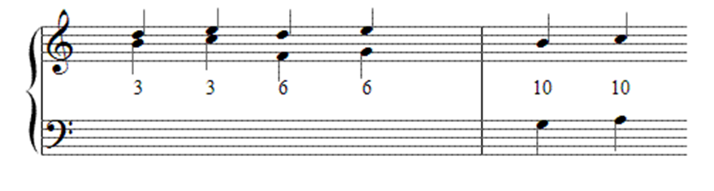
Parallel Motion
Parallel motion occurs when two voices move in the same direction, and with the same interval

Slide 7
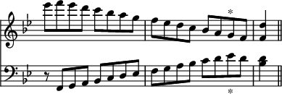
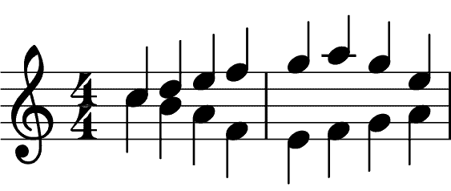
Contrary Motion
Contrary motion occurs when two voices move in the opposite direction

Slide 8
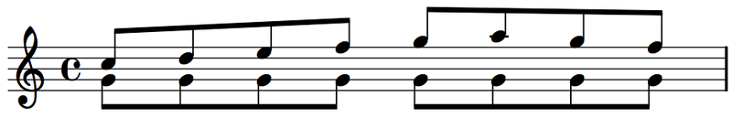
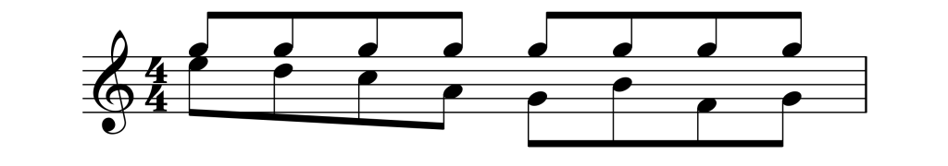
Oblique Motion
Oblique motion occurs when one voice holds its pitch, and the other voice changes pitch

Slide 9
Voice-Leading in CPITCH^2
Movement along depicted x-axis is oblique
Movement along depicted y-axis is oblique
Movement vertically is similar (parallel?)
Movement horizontally is contrary
Any path between two points in CPITCH^2 arises as a composition of these operations
Notes:
Moving horizontally is parallel motion (same interval)
Moving vertically is contrary motion
Moving along a diagonal is oblique motion

Slide 10
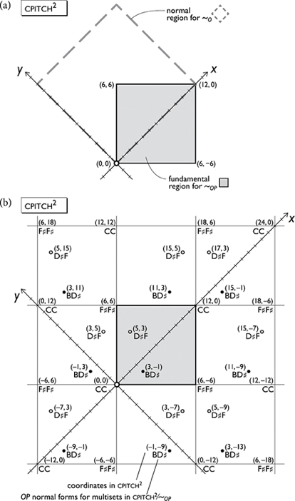

Slide 11
A Voice-Leading Path in CPITCH^2
(Processing Demo)

Slide 12
CPITCH^2 ~OP

Slide 13
Mathematical Description of CPITCH^2 ~OP

Slide 14
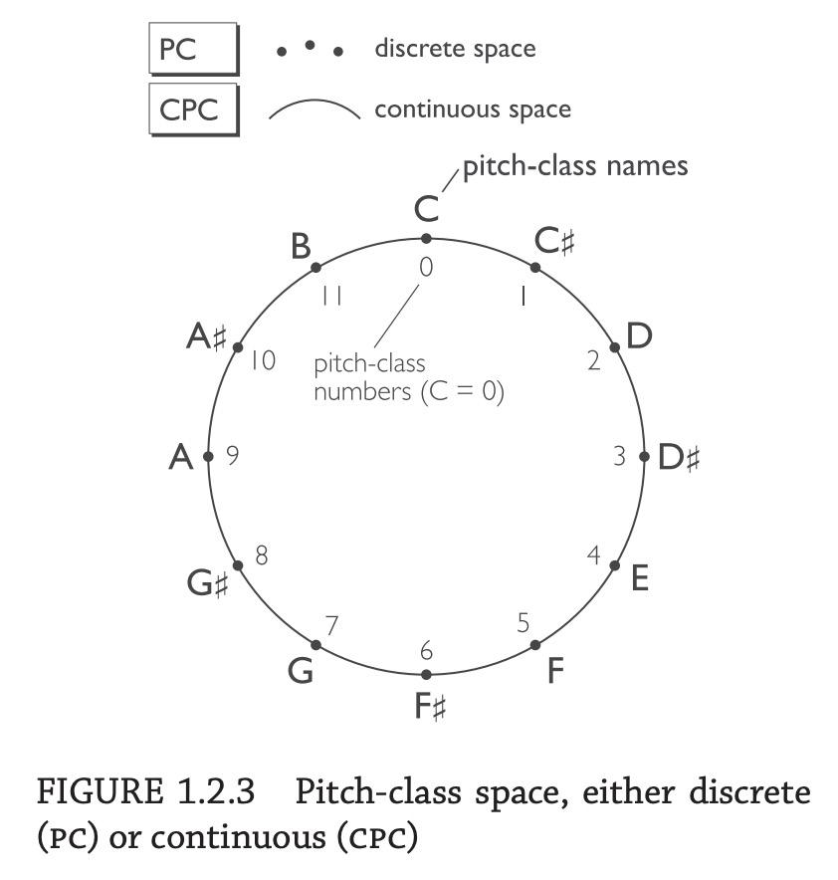
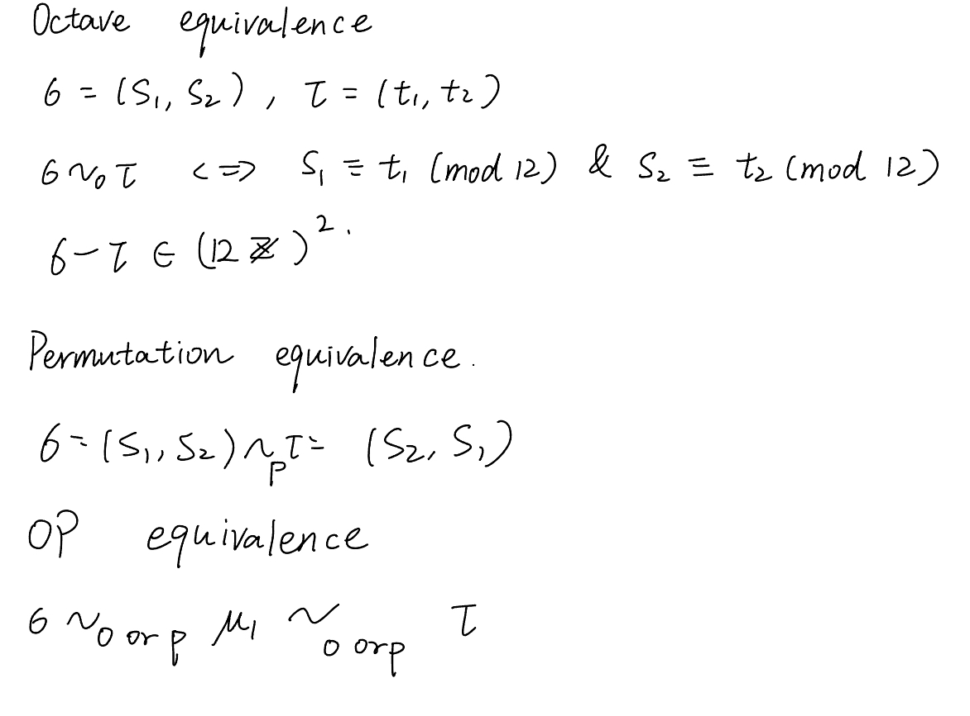
Octave and Permutational Equivalence
Octave equivalence is based on the mod 12 congruence of pitch numbers
Permutation equivalence means we can permute the order the pitches
Two pitches are OP equivalence means they are related by (multiple) octave or permutation equivalence relations

Slide 15
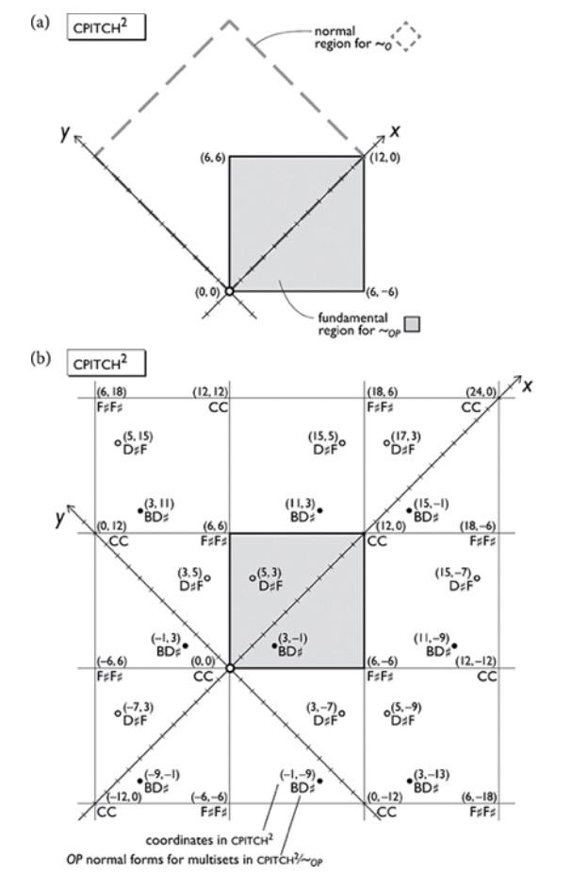
Fundamental region
Any point in the CPITCH^2 is OP-equivalent to a point in the fundamental region.

Slide 16
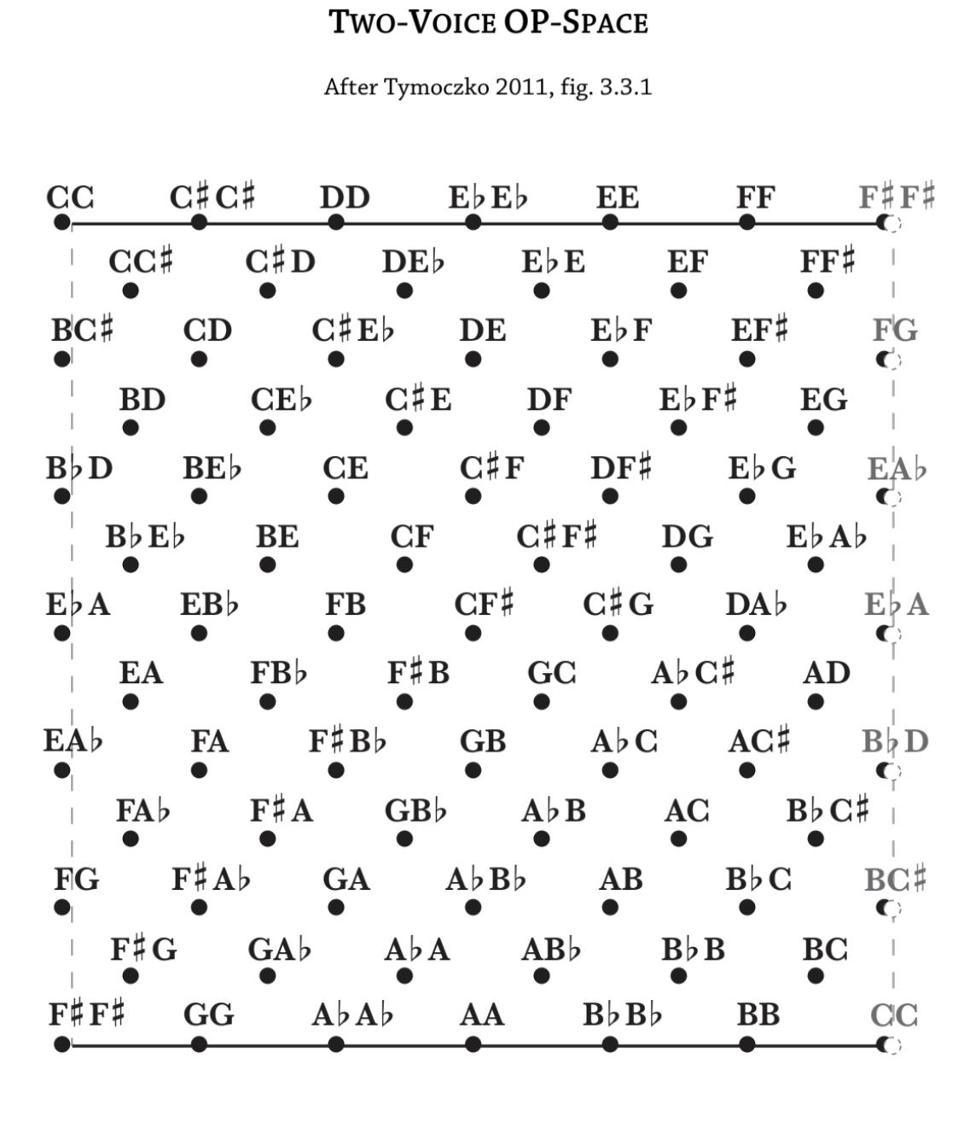
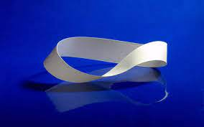
Möbius strip
Two-Voice OP space is obtained by identifying octaves and permutations as equivalent (e.g., C4~C5, [C,A]~[A,C]. The result is shown below; it is homeomorphic to (can be ‘wrapped into’) a mobius strip

Slide 17
Musical Interpretation of CPITCH^2 ~OP (Will)
(discussions of reflecting boundaries etc — see the material here: Feast Review - Google Slides) @will

Slide 18
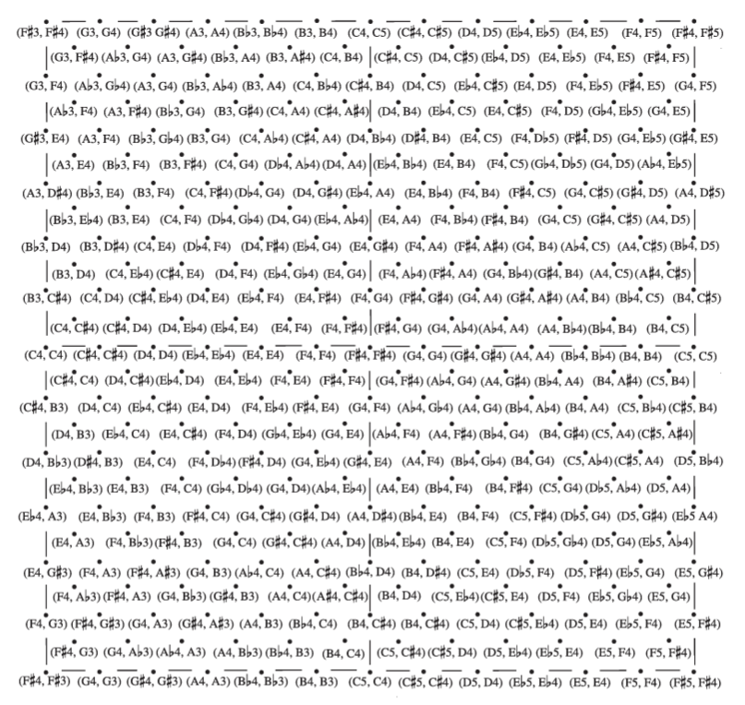
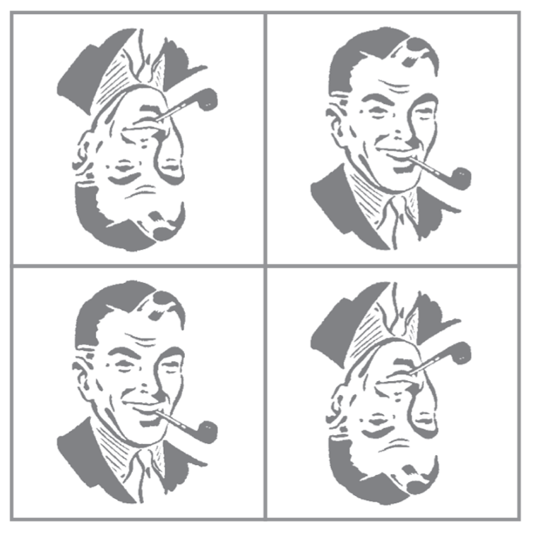
Ordered Pitch Space
Each tile, as represented by the image, is either reflected, translated, or rotated from the ‘initial’ image

Slide 19
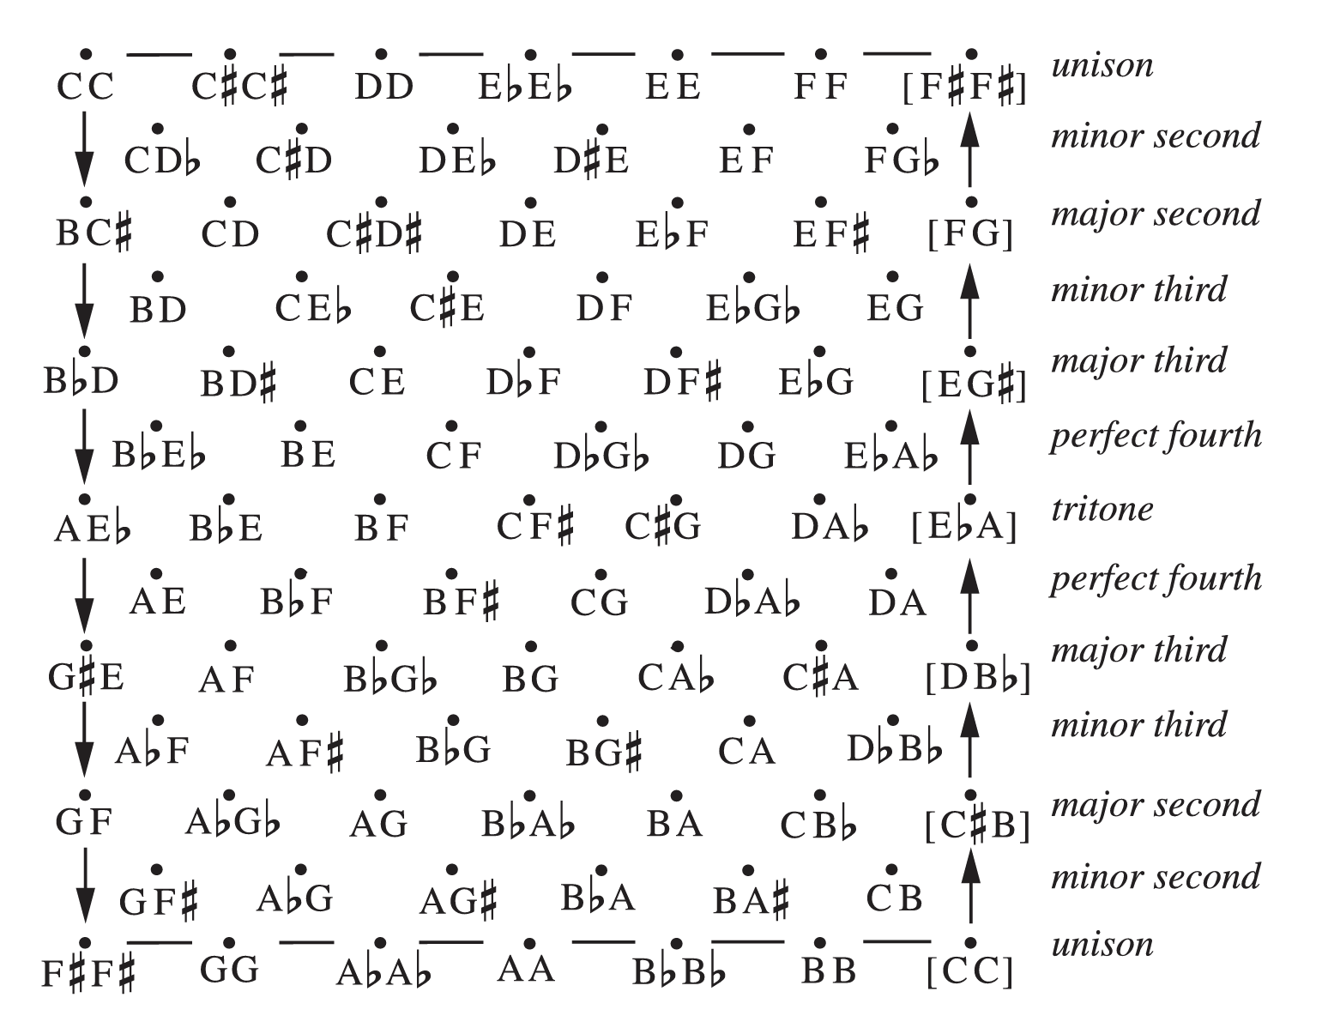
Two note chord space
Image of a single tile from the previous slide
Horizontal movement = Parallel motion
Vertical movement = Contrary motion
Diagonal Movement = Oblique motion

Slide 20
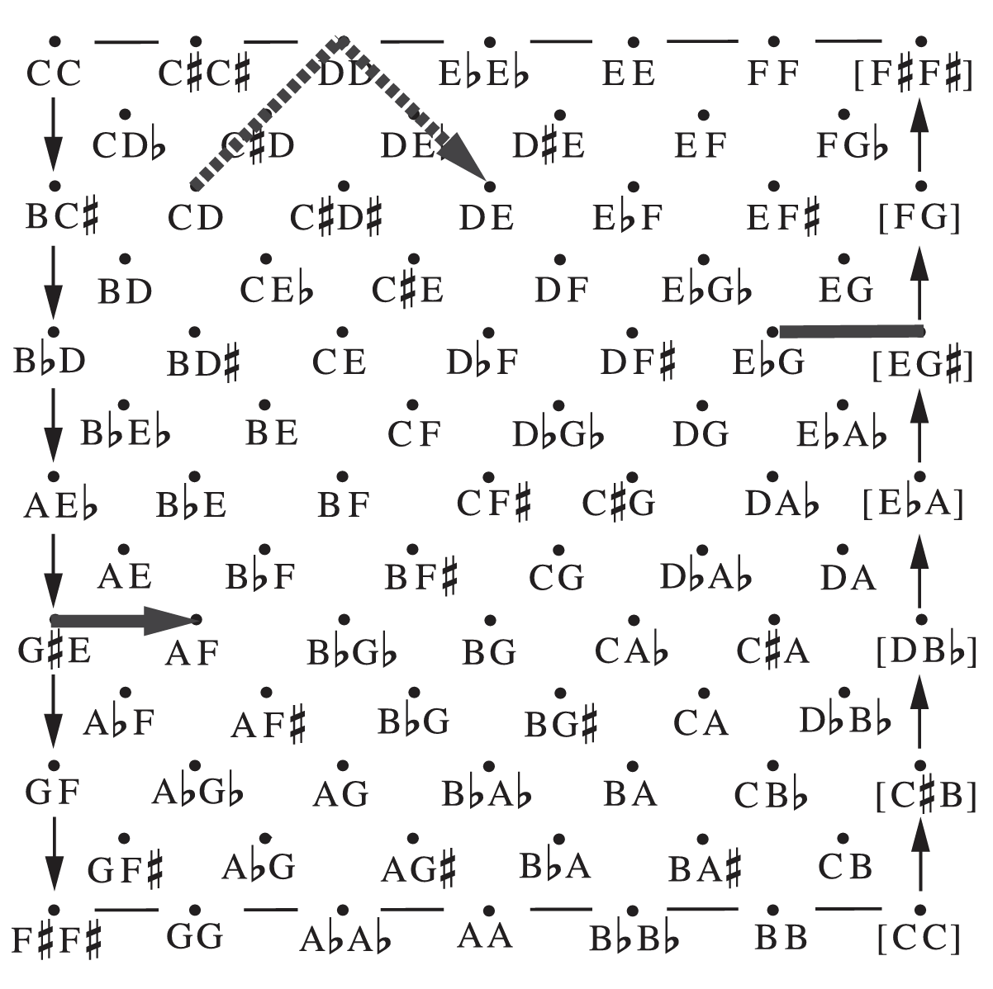
Top & bottom boundaries cause reflections
Left & right boundaries are “twisted” translations

Slide 21
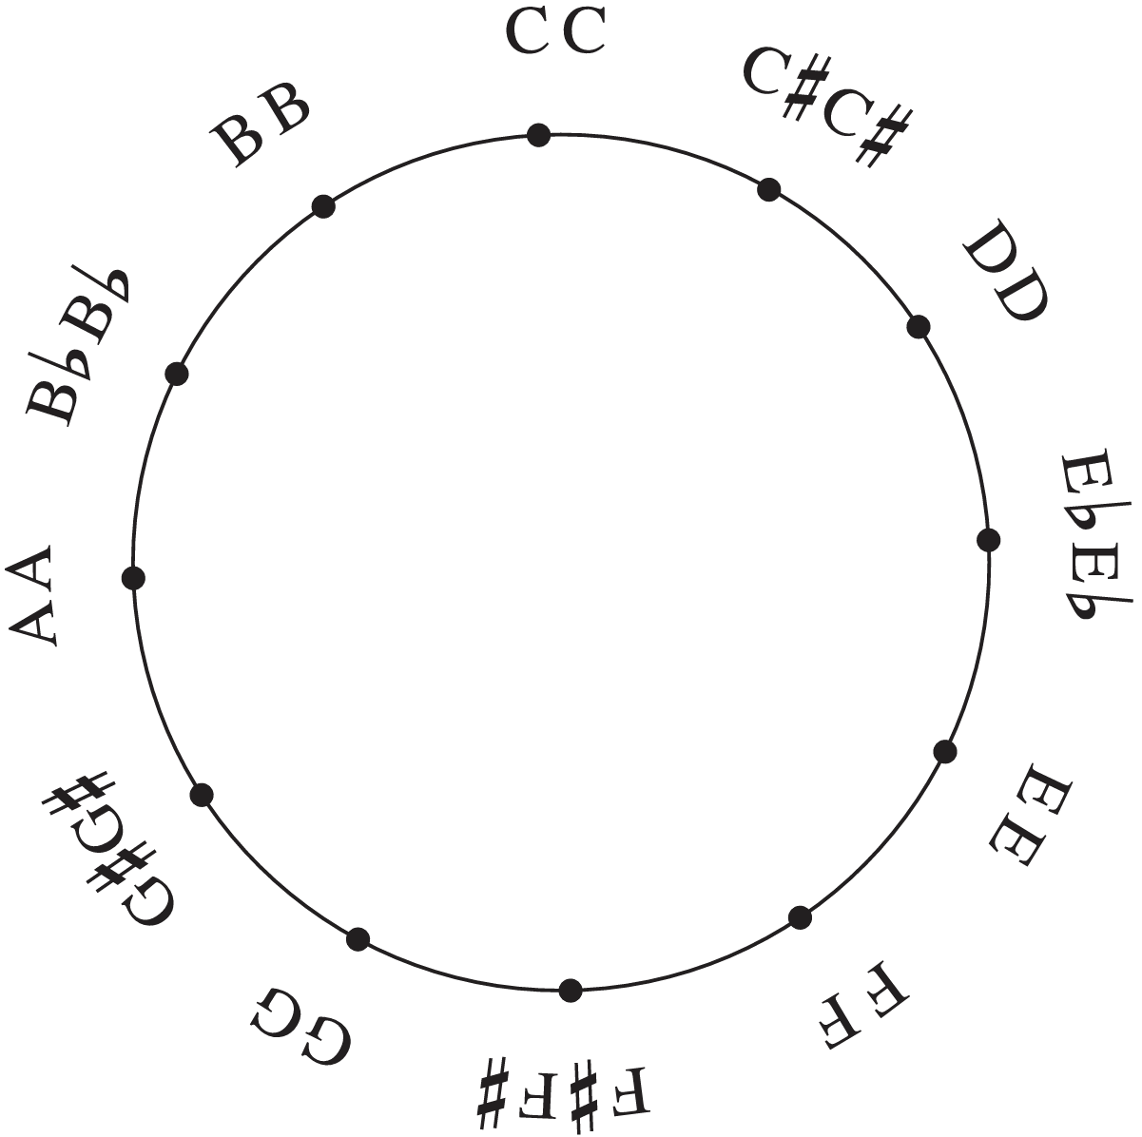
Top and bottom boundaries wrap around like a circle, very similar to the pitch class circle

Slide 22
A Voice-Leading Path in CPITCH^2 ~OP (Jake)

Slide 23
